Slide 1

Neural Network Models for Object Recognition Using Multi-Track ML Approaches
A study of Convolutional Neural Networks with CIFAR-10 Dataset

Slide 2
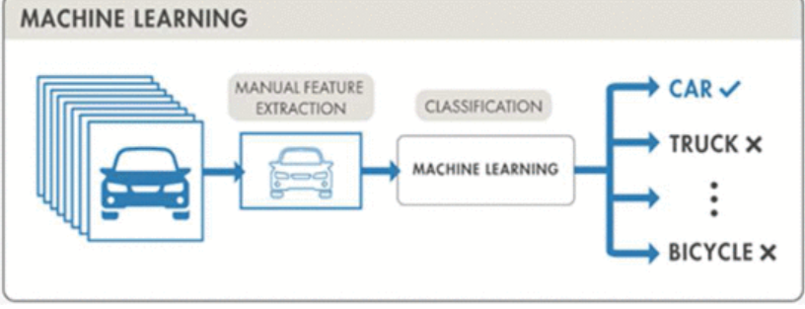
INTRODUCTION
Object recognition enables computers to identify and classify visual elements within images.
Machine learning and deep learning have significantly advanced recognition accuracy in recent years (Sarkar et al., 2024).
This presentation explores two neural network approaches using the CIFAR-10 dataset.
Figure 1: Object recognition using machine learning
(Sarkar et al., 2024)

Slide 3
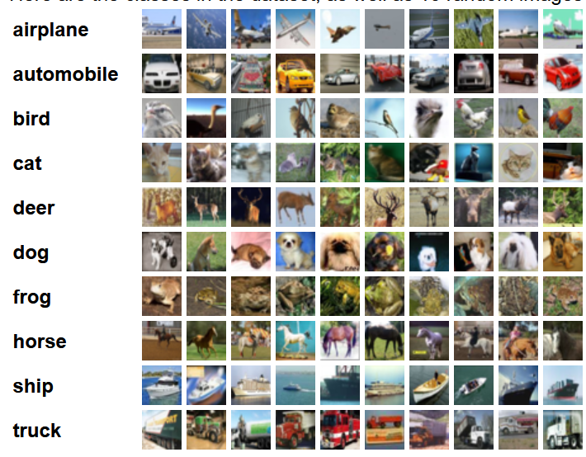
DATASET: CIFAR-10 OVERVIEW
60,000 colour images (32 × 32 × 3).
10 classes: Airplane, automobile, bird, cat, deer, dog, frog, horse, ship, truck
Training: 50,000 images Validation/Test: 10,000 images
Preprocessing: Normalisation, one-hot encoding.
Data Augmentation: Horizontal flip, rotation, zoom, shift
Figure 2: CIFAR-10 Dataset
Krizhevsky et al., 2009

Slide 4

DatA PrEPARATION and Preprocessing

Slide 5
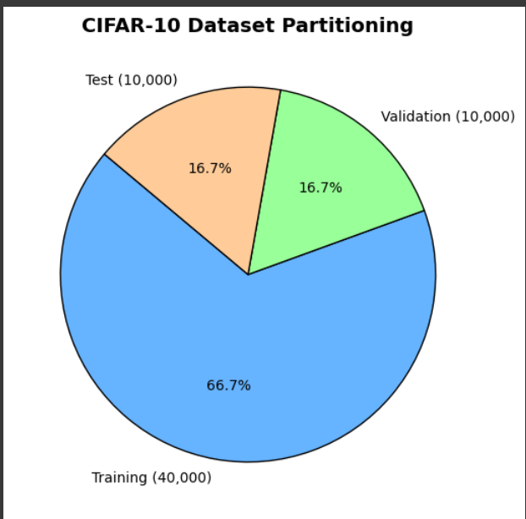
DATASET PARTIONINIG
Dataset divided into:
- Training: 40,000 (66.7%)
- Validation: 10,000 (16.7%)
- Test: 10,000 (16.7%)
Used stratified sampling to preserve class balance across subsets.
Validation set used to monitor model generalisation and prevent overfitting.
(Géron, 2022)

Slide 6
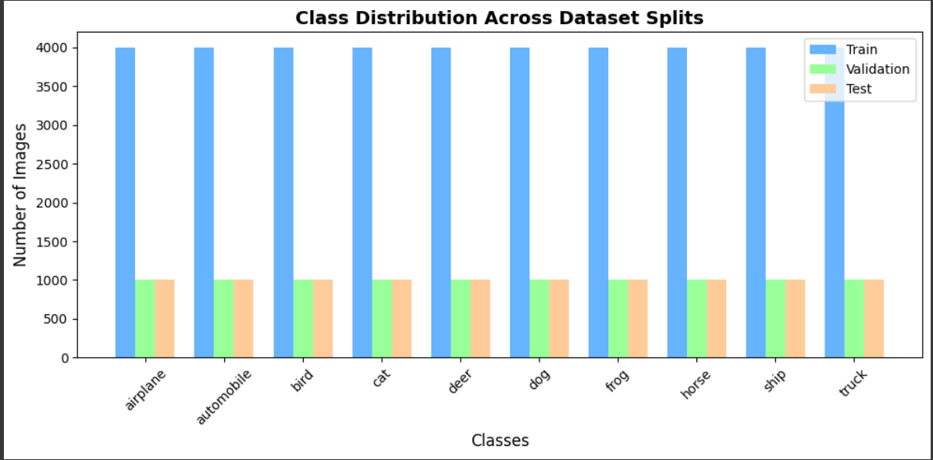
METADATA AND CLASSS DISTRIBUTION
Image dimensions: 32 × 32 × 3 (RGB)
Data type: float32
Pixel range: 0.0 – 1.0 (post-normalisation)
Mean RGB intensity: (0.49, 0.48, 0.45)
Standard deviation: ≈ 0.24 across channels
Dataset split: Train 40,000 | Validation 10,000 | Test 10,000.
Class balance preserved across splits (as shown in chart).

Slide 7
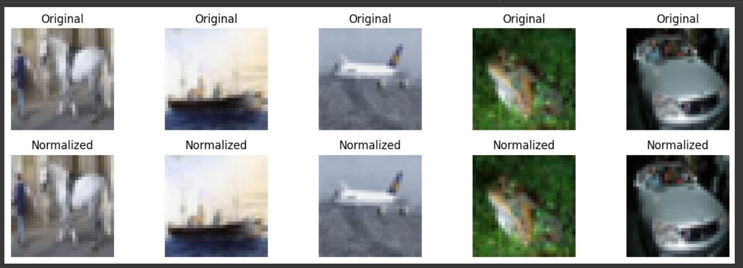
NORMALISATION
Normalisation rescales pixel intensity values from [0–255] to [0–1] without distorting image quality.
Pixel values in the CIFAR-10 dataset range from 0–255.
To improve model performance and stability, these values were scaled to the [0,1] range.
Normalisation ensures faster convergence and reduces gradient instability during training (Rawat and Wang, 2017).

Slide 8
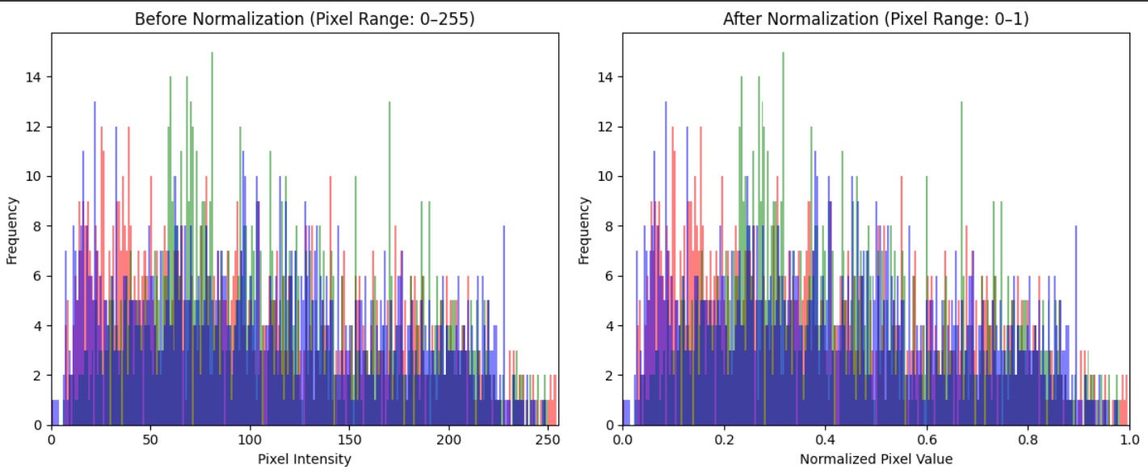
NORMALISATION HISTOGARM COMPARISON
Before normalisation: Pixel values spread between 0–255.
After normalisation: All values lie within 0–1 range.
Distribution shape preserved and only the scale was adjusted.
Normalisation reduces computation cost and enhances gradient flow.

Slide 9
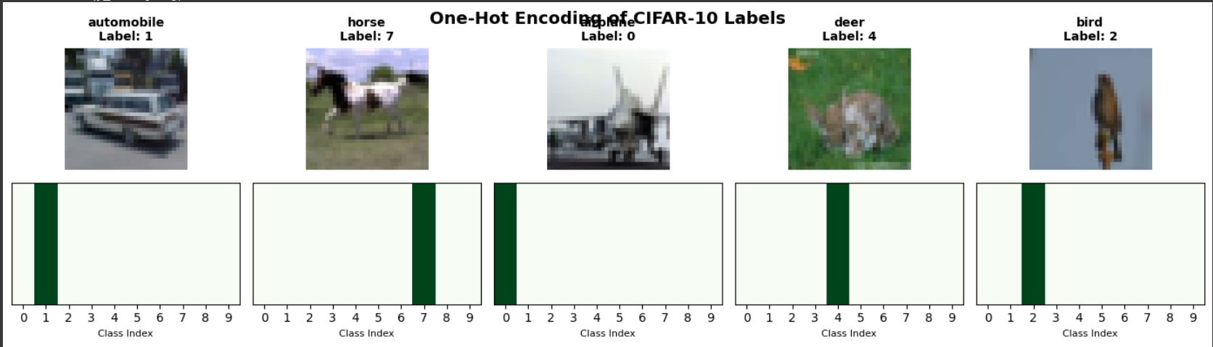
ONE - HOT ENCODING
CIFAR-10 has 10 categorical classes.
Labels converted into binary vectors (length = 10).
Each vector has a single “hot” value representing the class.
Prevents ordinal bias between categories.
Supports soft-max activation and cross-entropy loss.
(Zhu, Qiu and Fu, 2024).

Slide 10
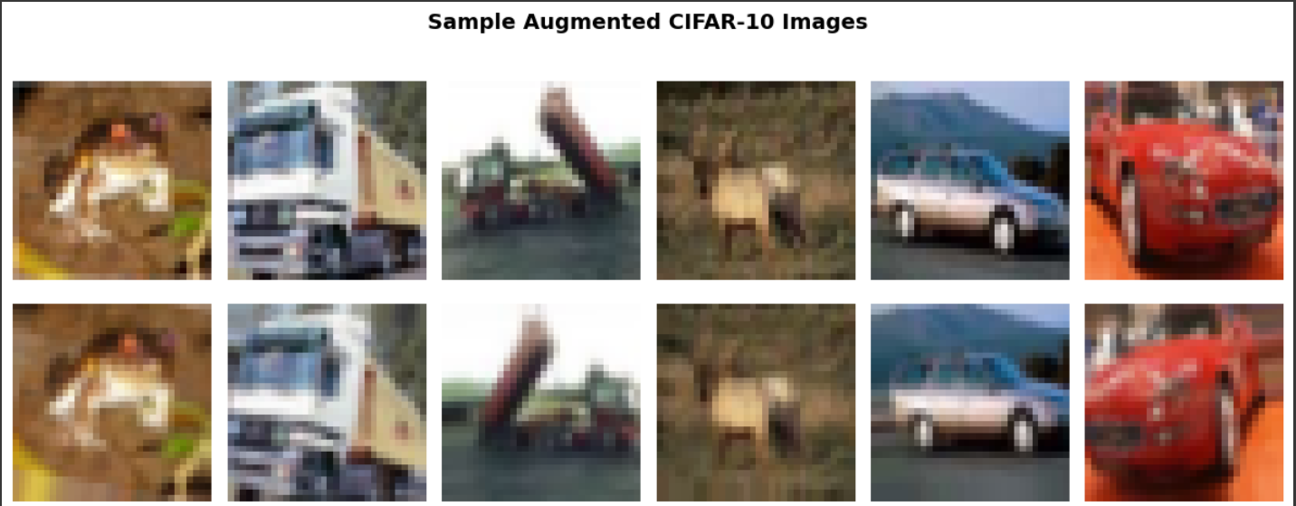
DATA AUGUMENTATION
Applied random transformations such as rotation, horizontal flips, and width/height shifts to training images only.
Augmentation increases dataset diversity without collecting new images.
Helps prevent overfitting by teaching the model to recognise objects from different angles and positions
(Shorten and Khoshgoftaar, 2019).

Slide 11
Model architecture

Slide 12
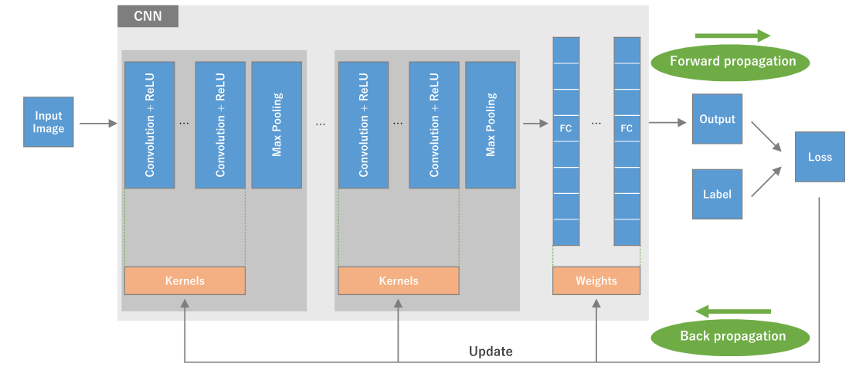
OVERVIEW OF CONVOLUTIONAL NEURAL NETWORK WORKFLOW
CNN extracts hierarchical features from input images using convolution and pooling layers.
Enables automated feature learning for accurate image recognition in CIFAR-10.
Minimises loss by adjusting kernels and weights during each iteration.
(Yamashita et al., 2018).
Figure 3: An overview of CNN training process
(Yamashita et al., 2018).

Slide 13
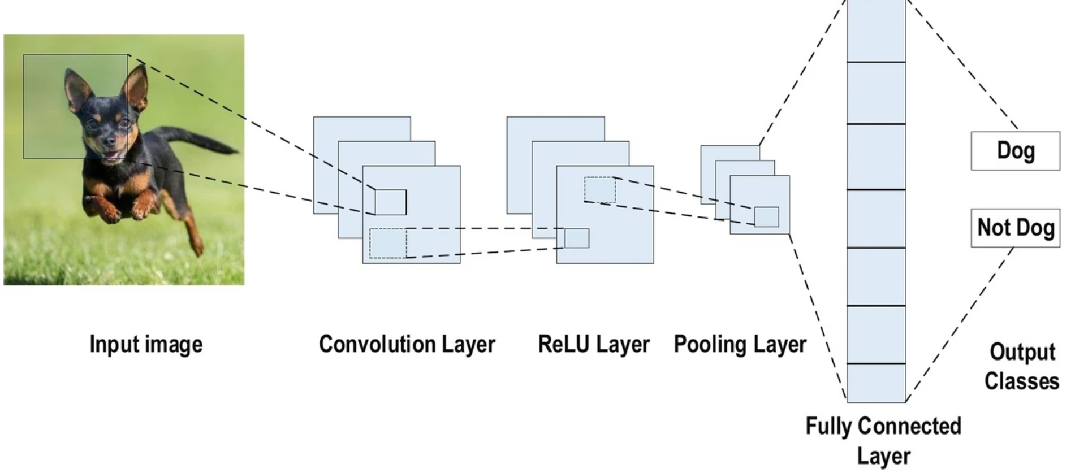
CNN ARCHITECTURE
Convolution layers detect local patterns such as edges or textures.
ReLU layers introduce non-linearity for better feature learning.
Pooling layers reduce spatial size and control overfitting.
Fully connected layers combine extracted features for final classification.
Output layer uses Softmax to predict class probabilities (e.g., airplane, car, dog).
(Rawat and Wang (2017).
Figure 4: An example of a CNN Architecture
(Alzubaidi et al., 2024)

Slide 14
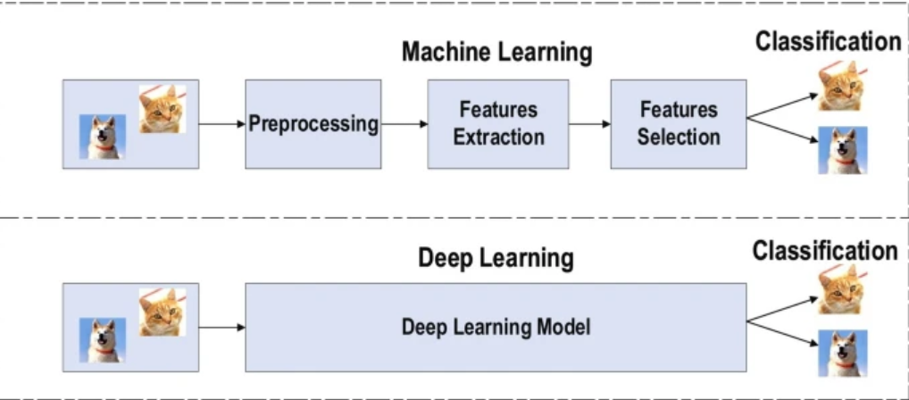
REASON FOR CHOSEN MODEL
Deep learning automates feature extraction.
CNNs learn complex visual patterns directly from raw pixel data.
Outperforms traditional ML for large-scale image datasets like CIFAR-10.
Simplifies workflow while improving accuracy and generalisation.
(Bhatt et al., 2021).
Figure 5: Difference between Machine Learning and Deep Learning (Alzubaidi et al., 2024)

Slide 15
Model 1

Slide 16
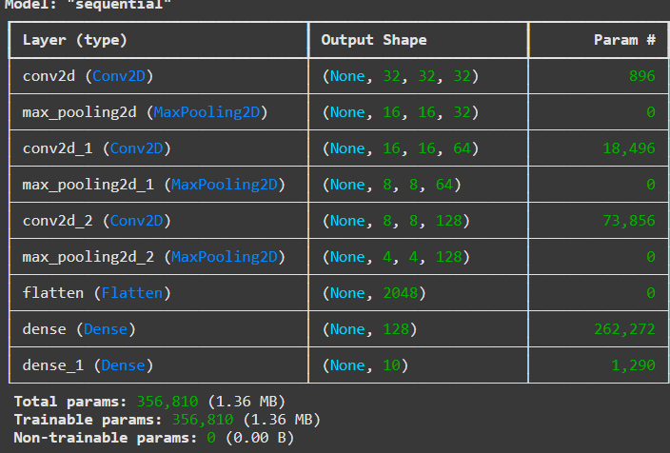
BASELINE CNN ARCHITECTURE
3 convolutional–pooling blocks progressively extract spatial features and reduce image dimensions (from 32×32 → 4×4).
Model 1 is lightweight with ≈356k trainable parameters, suitable for efficient training on CIFAR-10.

Slide 17
EPOCHS AND TRAINING STRATEGY
Purpose: To balance efficient learning with prevention of overfitting and optimise model generalisation.
Optimiser: Adam (adaptive learning for faster convergence).
Learning Rate: 0.001, reduced automatically on plateau.
Epochs: 15 with batch size of 64 but stopped early at epoch 9 (using Early Stopping).
Validation Split: 20% of training data reserved for validation.
Callbacks:
- ReduceLROnPlateau – lowers learning rate when validation loss stops improving.

Slide 18
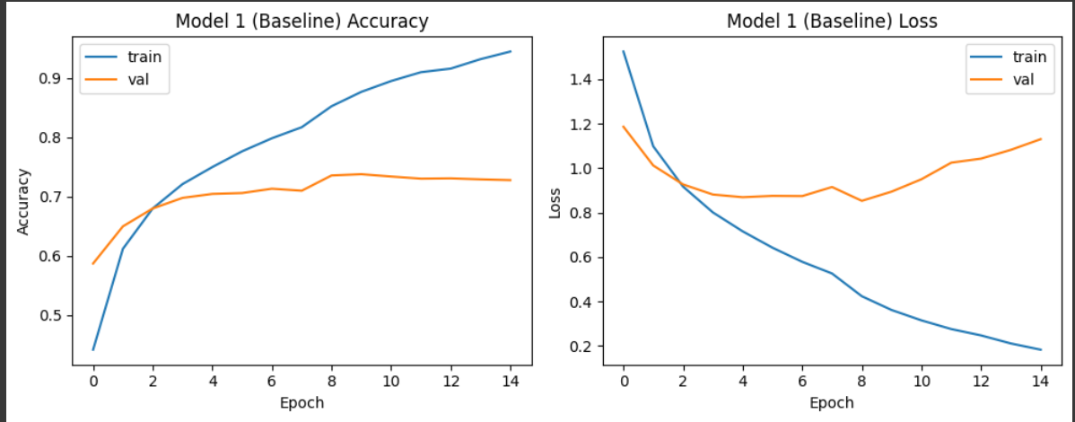
TRAINING PERFORMANCE
Training accuracy improved consistently, reaching 95% by the final epoch.
Validation accuracy plateaued around 73%, suggesting mild overfitting as training continued.
Training loss declined consistently, while validation loss began to rise after epoch 8, confirming the same overfitting trend.

Slide 19
EVALUATION METRICS
Metric | Training Set | Validation Set | Test Set | Interpretation
Accuracy | 0.8753 | 0.7358 | 0.7289 | Good learning on training data; validation and test results are consistent, showing generalisation.
Loss | 0.366 | 0.8529 | 0.8782 | Slight overfitting as validation/test loss remain higher than training loss.
Epoch at Best Model | 8 | - | - | Early stopping prevented further overfitting, saving the best-performing weights.

Slide 20
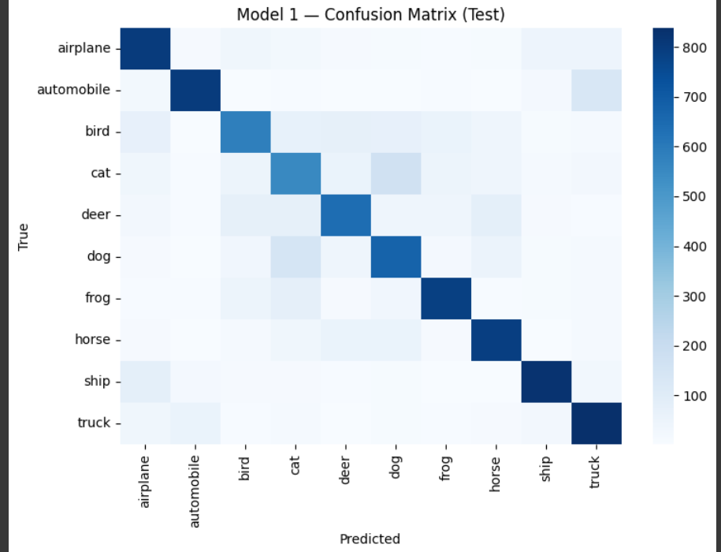
CONFUSION MATRIX
Strong diagonal pattern shows correct class predictions across all classes
Misclassifications occur mainly between similar classes (e.g., cats vs. dogs, airplanes vs. ships).
Highest performance was achieved for automobiles, ships, and trucks due to their distinctive visual features.
Overall test accuracy was approximately 73%, reflecting solid generalisation for a baseline CNN.

Slide 21
Model 2

Slide 22
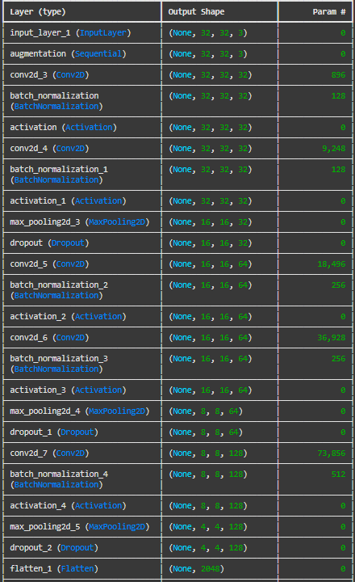
ENHANCED CNN ARCHITECTURE
Built on the baseline CNN with additional convolutional layers to deepen feature extraction.
Integrated Batch Normalisation after each convolutional layer to stabilise learning and accelerate convergence.
Added Dropout layers to reduce overfitting and improve generalisation.
Model includes approximately 530k trainable parameters, balancing performance and efficiency.

Slide 23
EPOCHS AND TRAINING STRATEGY
Purpose: To enhance the baseline model’s learning efficiency and generalisation by extending training duration and integrating adaptive callbacks.
Epochs: Trained up to 25 epochs (stabilised around epoch 20).
Batch Size: 64 (kept consistent for comparability).
Learning Rate: Initial value 0.001, reduced adaptively when validation loss plateaued.
Validation Split: 20% of training data reserved for model tuning.
Callbacks: Adam Optimiser
ReduceLROnPlateau: Automatically lowered learning rate to sustain improvement.

Slide 24
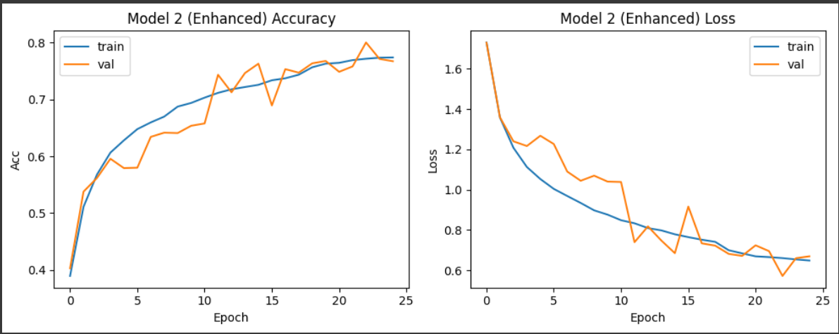
TRAINING PERFORMANCE
Training and validation accuracy both increased steadily, converging around 77–80% by the final epoch.
Validation performance remained close to training accuracy, indicating reduced overfitting.
Both training and validation loss decreased consistently, confirming stable optimisation.

Slide 25
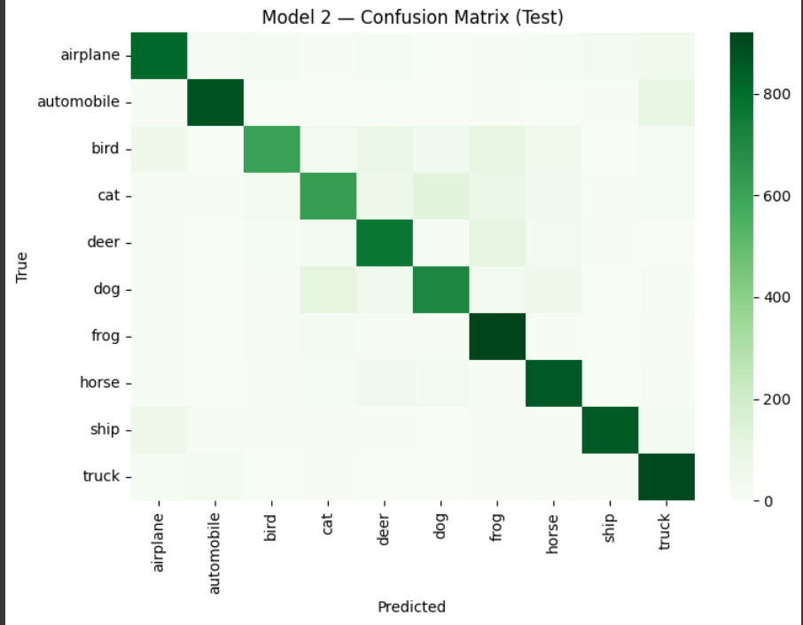
CONFUSION MATRIX AND INSIGHTS
Strong diagonal dominance indicates improved class prediction accuracy across all categories.
Misclassifications were reduced, especially between similar classes such as cats and dogs.
Distinct classes like automobiles, ships, and trucks maintain high recognition accuracy.

Slide 26
EVALUATION METRICS
Metric | Training Set | Validation Set | Test Set | Interpretation
Accuracy | 0.8270 | 0.8001 | 0.7950 | Higher accuracy across all sets compared to Model 1. Validation and test scores are closely aligned, showing improved generalisation.
Loss | 0.4918 | 0.5717 | 0.5996 | Lower loss across datasets, confirming better optimisation and stability. Minor gap suggests mild overfitting but within acceptable limits.
Epoch at Best Model | 20 | - | - | Model stabilised around epoch 20 before early stopping prevented overfitting.

Slide 27
MODEL 1 VS MODEL 2 COMPARSION
Metric | Model 1 (Baseline CNN) | Model 2 (Enhanced CNN) | Observation
Train Accuracy | 0.8753 | 0.8270 | Slightly lower due to regularisation but indicates reduced overfitting.
Validation Accuracy | 0.7358 | 0.8001 | Significant improvement, showing stronger generalisation.
Test Accuracy | 0.7289 | 0.7596 | Higher test accuracy confirms better real-world performance.
Train Loss | 0.366 | 0.4918 | Increased slightly due to dropout, helping generalisation.
Validation Loss | 0.8529 | 0.5717 | Reduced drastically, showing improved stability and lower overfitting.
Overfitting Trend | High (validation loss increased) | Reduced (training and validation closely aligned) | Enhanced architecture improved balance.

Slide 28



REFLECTION AND CONCLUSION
Demonstrated the impact of architectural refinement on model performance and stability.
Future improvements could include data augmentation, deeper architectures, or transfer learning.

Slide 29
References
Alzubaidi, L., Zhang, J., Humaidi, A.J., Al-Dujaili, A., Duan, Y., Al-Shamma, O., Santamaría, J., Fadhel, M.A., Al-Amidie, M. and Farhan, L. (2021) ‘Review of deep learning: concepts, CNN architectures, challenges, applications, future directions’, Journal of Big Data, 8(1), p. 53.
Bhatt, D., Patel, C., Talsania, H., Patel, J., Vaghela, R., Pandya, S., Modi, K. and Ghayvat, H. (2021) ‘CNN variants for computer vision: History, architecture, application, challenges and future scope’ Electronics, 10(20), p. 2470.
Géron, A. (2022) Hands-on machine learning with Scikit-Learn, Keras, and TensorFlow. O'Reilly Media, Inc.
Rawat, W. and Wang, Z. (2017) ‘Deep convolutional neural networks for image classification: A comprehensive review’, Neural computation 29(9), pp. 2352-2449.
Sarkar, T., Rakhra, M., Sharma, V., Takkar, S. and Jairath, K. (2024) ‘Comparative Study of Object Recognition Utilizing Machine Learning Techniques’, International Conference on Communication, Computer Sciences and Engineering pp. 726-731.
Shorten, C. and Khoshgoftaar, T.M.|(2019) ‘A survey on image data augmentation for deep learning’, Journal of big data 6(1), pp.1-48.
Yamashita, R., Nishio, M., Do, R.K.G. and Togashi, K. (2018) ‘Convolutional neural networks: An overview and application in radiology’ Insights into imaging, 9(4), pp. 611-629.
Zhu, W., Qiu, R. and Fu, Y. (2024) ‘Comparative study on the performance of categorical variable encoders in classification and regression tasks’ arXiv preprint arXiv:2401.09682.

